Slide 1

Christopher B. Barrett and Mark A. Constas
Cornell University
Presentation at the International Food Policy Research Institute
August 2, 2013
Toward A Theory of Resilience for International Development Applications

Slide 2

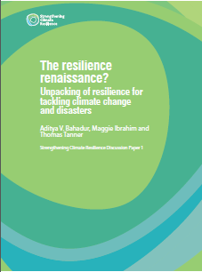
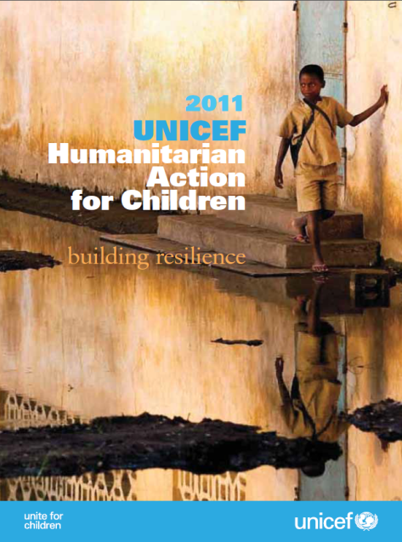
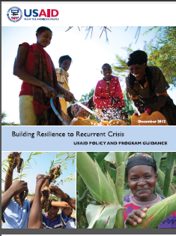
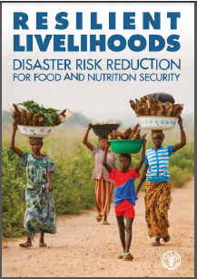
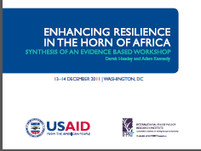
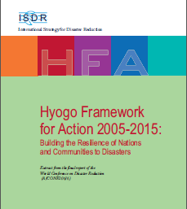
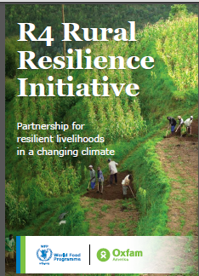

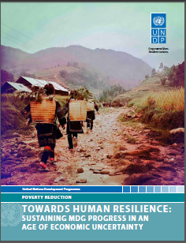

Motivation
“Resilience” has rapidly become a ubiquitous buzzword, but ill-defined concept within the development and humanitarian communities

Slide 3
Motivation
Why development and humanitarian communities’ current fascination with “resilience”?
Risk perceived increasing in both frequency and intensity
Recurring crises lay bare the longstanding difficulty of reconciling humanitarian response to disasters with longer-term development efforts.
Increasingly recognize interdependence of biophysical and socioeconomic systems. Tap ecological work on resilience.
But we lack a theory-measurement-and-evidence-based understanding of what resilience is with respect to poverty and hunger, how to measure it, and how to effectively promote it so as to sustainably reduce chronic poverty/food insecurity.

Slide 4
Motivation
At the same time, much ambivalence (or worse) about the ‘rise of resilience’
Seen as too imprecise and malleable a concept/term
Not pro-poor as presently formulated
Often ignores issues of agency/power
We aim to address these important critiques by advancing a simple initial theory of resilience that enhances precision and anchors the use of resilience in the broader struggle to reduce poverty and food insecurity.

Slide 5
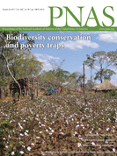
Need to Adapt
Existing economic theories of welfare dynamics (especially ‘poverty traps’) closely parallel the ecological literature on resilience and resistance: similar ODE-based mathematics of dynamical systems.
But foci differ – systems vs. individual
elements, role of human agency, the
normative project, etc. – so need to adapt
the ecological resilience literature using
the existing tools of development studies
and economics concerning the stochastic
dynamics of individual and collective
human well-being.

Slide 6
Toward a Theory
Resilience of whom to what?
Subject of interest – quality of life, roughly Sen’s ‘capabilities’.
This implies a focus on individuals’ (and groups’) well-being within a system, not the state of a system itself. System has instrumental rather than intrinsic importance.
Focus further on minimizing the human experience of chronic poverty.
Do not focus on a specific source of risk b/c problem is uninsured exposure to a wide array of stressors (ex ante risk) and shocks (ex post, adverse realizations) to which resilience implies adaptability while staying/becoming non-poor.

Slide 7
Toward a Theory
Concept of Resilience for Development
Development resilience represents the likelihood over time of a person, household or other aggregate unit being non-poor in the face of various stressors and in the wake of myriad shocks. If and only if that likelihood is and remains high, then the unit is resilient.
Key Elements: focus on stochastic dynamics of (aggregable) individual standards of living
Normative implication: prioritize avoidance of and escape from chronic poverty and minimize within the population and over time the experience of low standards of living.

Slide 8
Toward a Theory
Stochastic Well-Being Dynamics
Consider the moment function for conditional well-being:
m^{k}(W_{t+s} | W_{t}, ε_{t})
where m^{k} represents the k^{th} moment (e.g., mean (k=1), variance (k =2) or skewness (k =3)
W_{t} is well-being at time t
ε_{t} is an exogenous disturbance (scalar or vector) at time t
These moment functions describe quite generally, albeit in reduced form, the stochastic conditional dynamics of well-being.

Slide 9
Toward a Theory
Ex: Nonlinear expected well-being dynamics with multiple stable states (m¹(W_{t+s} | W_{t}, ε_{t}) )
Noncontroversially: NPZ >> CPZ >> HEZ
Those in CPZ or HEZ are chronically poor in expectation (E[W∞]<p)
The CEF reflects indiv/collective behaviors (agency/power) w/n system

Slide 10
Toward a Theory
The development ambition is to move people into the non-poor zone and keep them there.
The humanitarian ambition is to keep people from falling into HEZ … offers foundation of a rights-based approach to resilience.
For the current non-poor, seek resilience/resistance against shocks in the ecological sense: no shift to either of the lower, less desirable zones.
But for the current poor, those in HEZ/CPZ, the objective is productive disruption, to shift states to the NPZ.
Asymmetry is therefore a fundamental property of resilience against chronic poverty. Thus stability ≠ resilience.

Slide 11
Toward a Theory
Explicitly incorporate risk by integrating broader set of moment functions to move from CEF to CTDs:
Note: Transitory shocks (- or +) can have persistent effects
Risk endogenous to system state
CTDs reflect both natural and socioeconomic contexts

Slide 12
Programming implications
Objective: min likelihood people fall into HEZ/CPZ
Three options:
Shift people’s current state – i.e., increase W_{t}. Ex: transfers of cash, education, land or other assets.
Alter CTDs directly through risk reduction/transfer (∆s system too). Ex: social protection - EGS, insurance, improved police protection, drought-resistant varieties.
Change the underlying system structure – institutions/ technologies – induces ∆ in behaviors and CTDs. Prob: multi-scalar reinforcement – ‘fractal poverty traps’
Must explore the feedback within broader system to identify possible intervention points behind univariate dynamics.
W_{t}
W_{t}

Slide 13
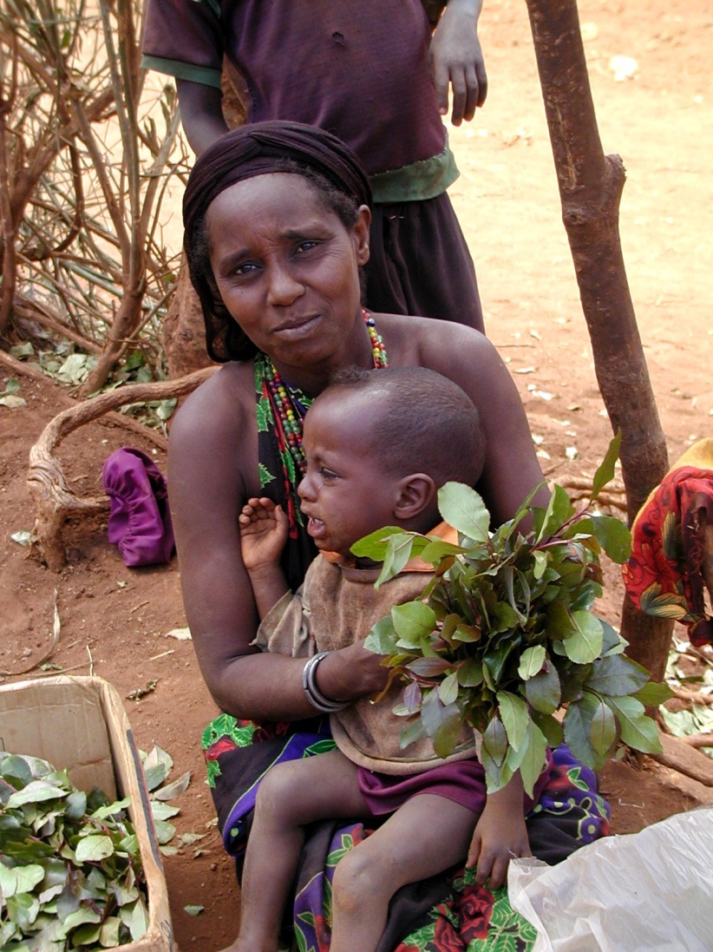
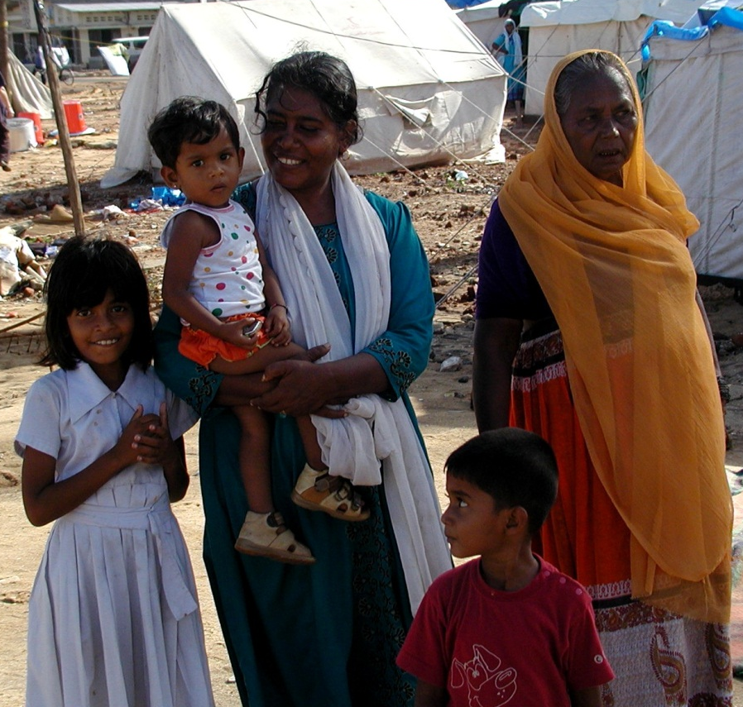

Programming implications
The role of social institutions, power, exclusion and solidarity
“A tale of two widows”
And would the widower’s dynamic = the widow’s?

Slide 14
Toward Systems Integration
Feedback between sub-systems can be crucial
Generalize to admit the role of the natural resource state, R_{t}:
m^{k}(W_{t+s} | W_{t}, R_{t}, ε_{t})
And recognize that parallel dynamics exist for the resource:
rm^{k}(R_{t+s} | R_{t},W_{t}, ε_{t})
Now feedback potentially arises between R and W
(e.g., range conditions depend on herd size/stocking rate, disease reproduction depends on household incomes)
Or at least correlation due to ε_{t} (e.g., climate).
Then the resilience of the underlying resource base becomes instrumentally important to resilience against chronic poverty.

Slide 15
Toward Systems Integration
Coupled human and natural systems dynamics
Problem: - Many candidate contemporaneous relationships between
R_{t} and W_{t} (e.g., EKC vs. soil degradation thresholds) make
prediction difficult at best.

Slide 16
Toward Measurement and Evaluation
If agencies program around resilience goals, then we need to be able to measure it and evaluate program/project performance. Should use theory to guide measurement.
Key measurement implications of this theory:
Estimate the conditional moment functions for well-being, m^{k}(·), and the natural resource base, rm^{k}(·).
Use estimated moments to estimate the probability of poverty in each of a sequence of time periods.
Based on a normative assessment of an appropriate tolerance level for the likelihood of being poor over time, individuals, households, communities, etc. could be classified as resilient or not.
Then do impact evaluation based on such measures.

Slide 17
Summary
Resilience is a popular buzzword now. But little precision in its use, theoretically, methodologically or empirically.
We aim to help facilitate rigorous, precise use of the concept to help identify how best to avoid and escape chronic poverty.
This will require advances in theory, systems integration, measurement and empirical work in many different contexts and over time.
Much to do in all areas … a massive research agenda, especially as agencies begin using resilience as a programming principle.
But we must start with a firm theoretical foundation.

Slide 18
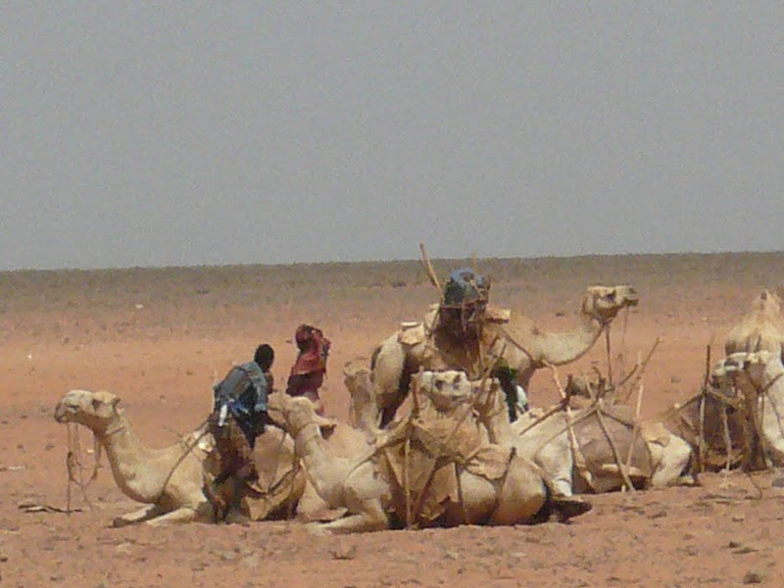
Thank you
Thank you for your time, interest and comments!

